Slide 1

Customer Shopping Behavior Analysis

Slide 2






Project Overview: Unlocking Customer Insights
This project analyzed 3,900 customer purchases to understand shopping patterns, segment customers, evaluate product performance, and analyze subscription trends. The goal is to support data-driven business decisions.
Python
SQL
Power BI
Data cleaning & preparation
Structured business analysis
Interactive visualization
Key insights were derived from demographics, purchase history, discounts, shipping, and reviews, leading to an analytical report and interactive dashboard.

Slide 3

Business Problem Statement
Retailers generate vast transactional data, but often miss valuable insights into customer behavior. Understanding spending habits, product preferences, discount usage, and subscription status is crucial for improving sales and retention.
Identify Trends
Evaluate Influencers
Analyze customer shopping data to identify key behavioral trends and segments.
Assess factors influencing purchasing and repeat buying decisions.
Support Decisions
Provide data-driven insights for marketing, product positioning, and customer engagement.

Slide 4
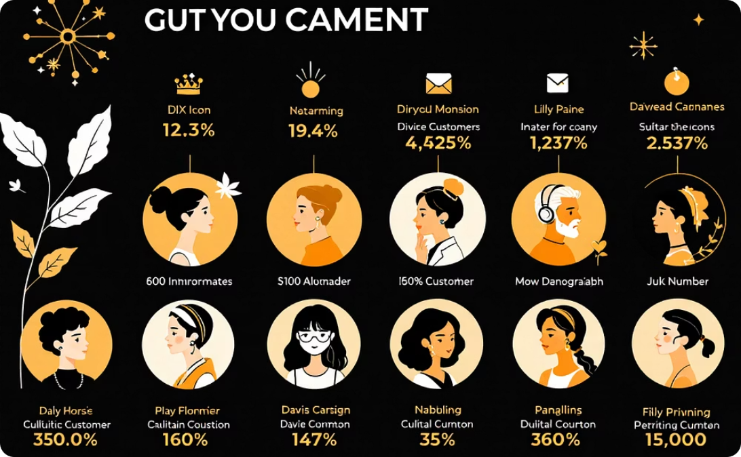


Dataset Summary: Customer Transactions
This project used a customer transactions table with 3,900 records and 18 columns, each representing a unique purchase.
Demographics
Purchase Attributes
Behavior Indicators
Customer age, gender, and location details.
Product categories, purchase amounts, and dates.
Subscription status, discount use, previous purchases, and review ratings.
Missing values in review ratings were addressed during preprocessing to ensure data consistency.

Slide 5




Data Analysis Workflow
A structured analytics workflow transformed raw transactional data into meaningful business insights.
Data Preparation
Using Python for loading, cleaning, and preprocessing, including handling missing values and feature engineering (age groups, customer segments).
Data Analysis
SQL queries on cleaned data to analyze customer behavior, spending, product performance, discounts, and subscriptions.
Data Visualization
Power BI for an interactive dashboard, presenting key metrics and trends for data-driven decision-making.

Slide 6
Key Insights from Customer Data
1
Revenue by Gender
Male customers generated significantly higher total revenue.
2
Discount Users
High-spending customers frequently used discounts, suggesting effectiveness in driving higher-value purchases.
3
Top-Rated Products
Gloves, Sandals, Boots, Hats, and Skirts received the highest average review ratings.
4
Shipping & Spending
Express Shipping correlated with slightly higher average purchase amounts.
5
Customer Segmentation
Majority were Loyal, followed by Returning, indicating strong repeat purchasing.
6
Revenue by Age
Young Adults and Middle-aged customers contributed the highest revenue.

Slide 7
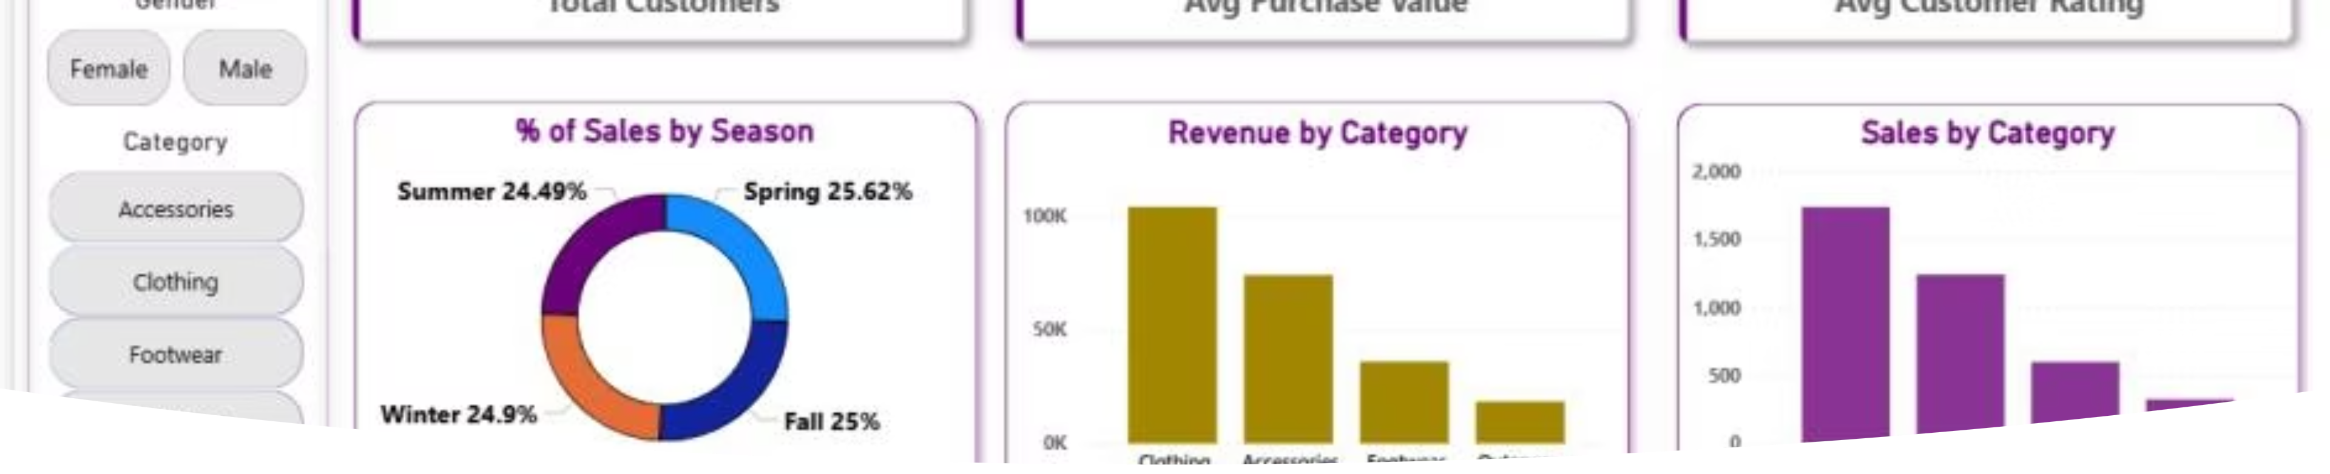
Dashboard Overview: Power BI
An interactive Power BI dashboard visually presents key insights, offering a consolidated view of customer behavior.
It includes KPIs like total customers, average purchase amount, and review ratings, with breakdowns by category, age, and subscription status. Interactive filters allow dynamic data exploration.

Slide 8
Business Recommendations
Actionable strategies based on customer shopping behavior analysis.
Strengthen Subscriptions
Strategic Discounts
Promote Top Products
Offer exclusive benefits to improve retention and convert repeat buyers.
Target price-sensitive products (hats, sneakers) to boost sales, monitoring margins.
Capitalize on strong customer preferences for top-rated and best-selling items.
Target Key Segments
Encourage Premium Shipping
Prioritize marketing for young adult and middle-aged customers, who drive most revenue.
Highlight benefits of express shipping due to its correlation with higher purchase values.

Slide 9






Conclusion: Data-Driven Success
This project successfully analyzed customer shopping behavior, translating transactional data into actionable insights for retail business performance.
Discount Optimization
Smarter use of promotions to drive sales.
Customer Engagement
Improved strategies for connecting with shoppers.
Subscription Retention
Strengthening loyalty through subscription models.
By combining Python, SQL, and Power BI, the analysis supports informed decision-making and enhances overall retail business performance.

